Slide 2

What can you do with this much money?

Slide 3

What can you do with this much money?

Slide 4

What can you do with this much money?

Slide 5

What can you do with this much money?

Slide 6
2004 – 1 semiconductor plant costs

Slide 7
2011 – 1 semiconductor plant costs

Slide 8
2020 – 1 semiconductor plant costs

Slide 9
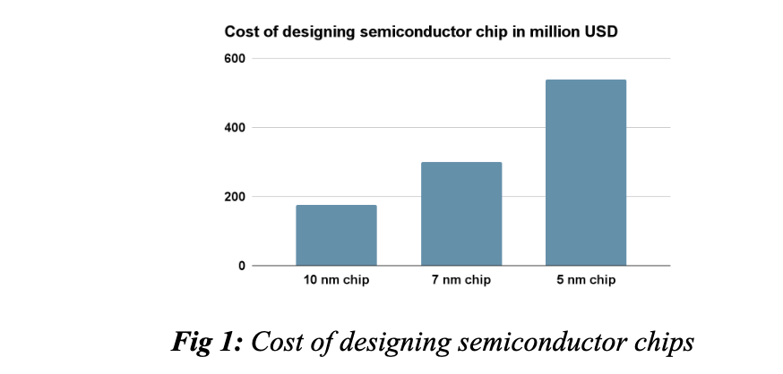

Slide 10
outsourcing
these fabless companies generate one-third of industry revenue
lower input costs as they pool production with other fabless companies in third-party foundries
and allows them to take advantage of lower foreign wages and weaker environmental standards.

Slide 11
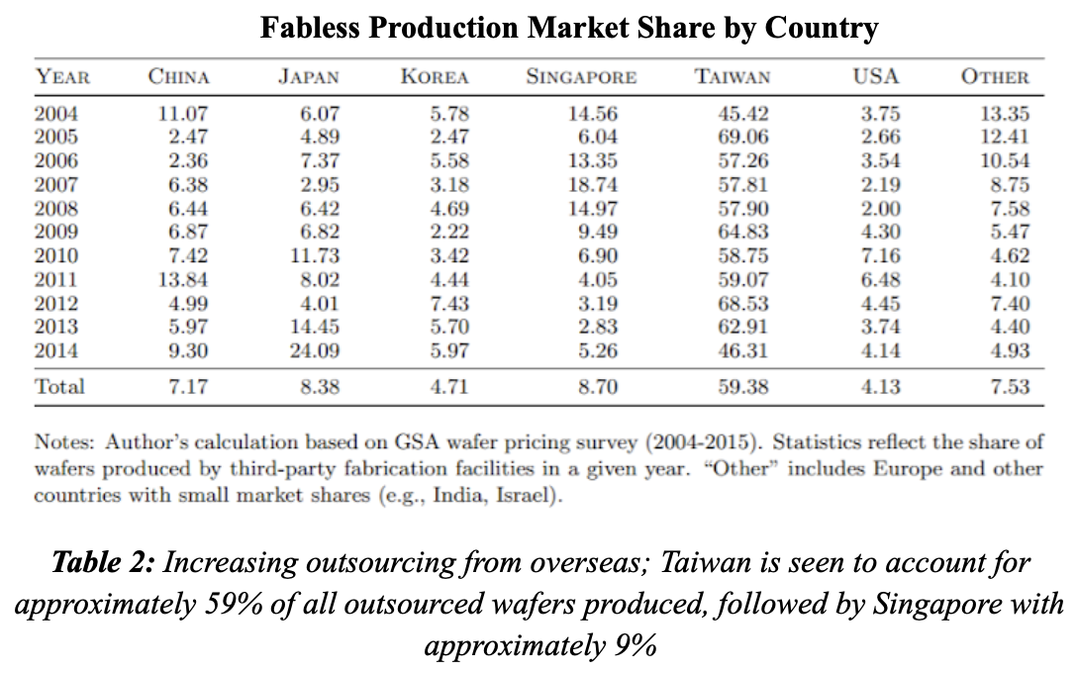
overall net reduction of capital expenditures in the industry,
27% (1996-2001) --→ 20% (2002-2009)

Slide 12
Technology
research and development spending by semiconductor companies worldwide is forecast to grow 4% in 2021 to $71.4 billion after rising 5% in 2020 to a record high of $68.4 billion.

Slide 13
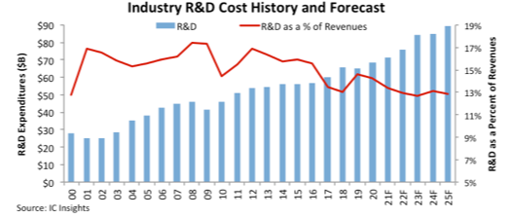

Slide 14
The graph above plots semiconductor R&D spending levels and the spending-to-sales ratios over the past two decades and IC Insights’ forecast through 2025. It can be seen that there is a clear increasing trend in the amount of money spent on R&D, yet a decreasing trend in the values of R&D as a percentage of Revenues

Slide 15



5-nanometer plus, or N5P takes at least three months.
the companies still need to keep up with the production of the previous technologies
iPhone 12's A14 chip requires a 5 nm chip, a 7nm chip is still required for iPhone 11’s A13 chip and iPhone XS’s A12 chip
to mass-produce 5 nm chip by 2024, TSMC build a $12 billion chip plant
iPhone 12
iPhone 11
iPhone XS

Slide 16
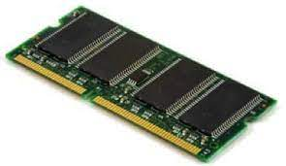
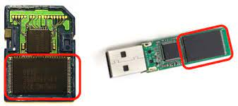
Assessment of micron
Micron, one of the major suppliers of DRAM and NAND memory → needs to produce advanced 3D Nand flash memory chips used to produce solid-state drives that are used in smartphones, tablets and computer
NAND
DRAM

Slide 17
Conclusion
Expectation of Returns: Break-even Analysis
Demand Projection Forecast
R&D: Advancement of Technologies
Micron is a GOOD candidate for expansion

